Slide 1

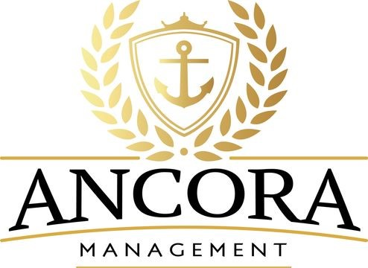

Slide 2
Our partnership role
Ancora exists to serve St. Johns Classical Academy (SJCA) in vital areas that the Governing Board is responsible for overseeing. The success of a charter school, such as SJCA, is dependent on a very wide spectrum of parameters that are not all ostensibly related to education but are necessary for the viability of the organization. Ancora provides the foundation and function of the business aspect of an effective school, allowing the Head of School to focus on the needs of the school.
Ancora serves at the pleasure of the Governing Board and in partnership with the Head of School. Beyond the Ancora management team, there are staff members centered around each key area of responsibility along with third party, trusted vendors. Consider Ancora your “district office”.

Slide 3
Who we are and what we do
MANAGEMENT TEAM
Diane Hutchings and Amy Miller
Managing Partners
Founding board members of St. Johns Classical Academy. Expertise in school start-up services including planning, charter creation, funding, construction management, marketing, business management, public relations, etc.
Steve Amburgey, Director of Operations
Anything and everything SYNERGY
State Assessment / School Grades / Scholar Proficiency Tracking
Manage all electronic platforms
Bright Futures / Scholar Course History
Dr. Susan Legutko, Director of Finance & Compliance
Partner with schools and CharterSage CPA firm for complex financial requirements including budgets, NSLP, compliance, etc.

Slide 4
Who we are and what we do
Michelle Rencarge, Director of Human Resources
Payroll, benefits (medical, etc), principal retirement, employee contracts, EAP program
Onboarding/off-boarding , employee portal, Timeco, PTO, email set ups, software access
Password Management- building remote access control
Employee concerns/complaints
Risk management - workers compensation, school general liability insurance
Employee engagement system
Governing Board Meeting Minutes
Dina Sakowski, School Support Coordinator
Governing Board Meetings / Governing Board Management
MySchoolBucks, MySchoolApps & Mosaic Support, including set-up, reporting, nightly data feeds, refund processing, etc.
Public Records Requests
Bond, Charter & CCDS Compliance
Scholar Exit Surveys
Special Projects
Ancora Business Office Manager

Slide 5
Who we are and what we do
Maxine Johnston, Registration & Enrollment Coordinator
SchoolMint (lottery and registration)
Synergy (registration and scholar data)
Scholar records and transcripts
State FTE Funding
Attendance (teacher and scholar levels)
Terri Hopkins, Computer Apps & State Reporting Specialist
SchoolMint (lottery and registration)
Synergy (assist with registration & scholar data)
State FTE Funding
Scholar Class Schedules

Slide 6
Who we are and what we do
Susan Williams, Accounting Manager
Accounting for internal funds including A/R, A/P, General ledger & monthly reports
Partner with CharterSage CPA firm for operational accounting including review of ledgers, preparing budgets & requesting escrow bond reimbursements
Manage cash flow
Accounting policies and procedures
Special Projects
Georgia Kiczek, Staff Accountant
Grant Management including reimbursement requests, amendments, balance tracking, etc.
Inventory maintenance and reporting
Accounts Payable; Transitioning into responsibilities for all accounting matters for Orange Park Campus
Accounting back-up for Fleming Island Campus
Special Projects

Slide 7


We’re here for you…
How can we help??
Diane Hutchings, Managing Partner
diane.hutchings@stjca.org
(904) 710-1469
Amy Miller, Managing Partner
amy.miller@stjca.org
(904) 591-3333
Steve Amburgey, Director of Operations
steven.amburgey@stjca.org
(904) 637-4863
Susan Legutko, Director of Finance & Compliance
susan.legutko@stjca.org
(904) 568-0711
Michelle Rencarge, Director of Human Resources
michelle.Rencarge@stjca.org
(904) 637-4833
Dina Sakowski, School Support Coordinator
dina.Sakowski@stjca.org
(904) 637-1416
Maxine Johnston, Registration & Enrollment Coordinator
maxine.johnston@stjca.org
(904) 637-4849
Terri Hopkins, Computer Apps & State Reporting Specialist
terri.hopkins@stjca.org
(904) 637-1475
Susan Williams, Accounting Manager
susan.williams@stjca.org
(904) 637-1660
Georgia Kiczek, Staff Accountant
georgia.kiczek@stjca.org
(904) 637-4865

